Slide 1
Secondary Admissions 2027

Slide 2
Diary dates
Secondary portal opens to receive applications: 11 September 2026
Closing date for all on-time applications: 31 October 2026
Secondary National Offer Day: 1 March 2027

Slide 3
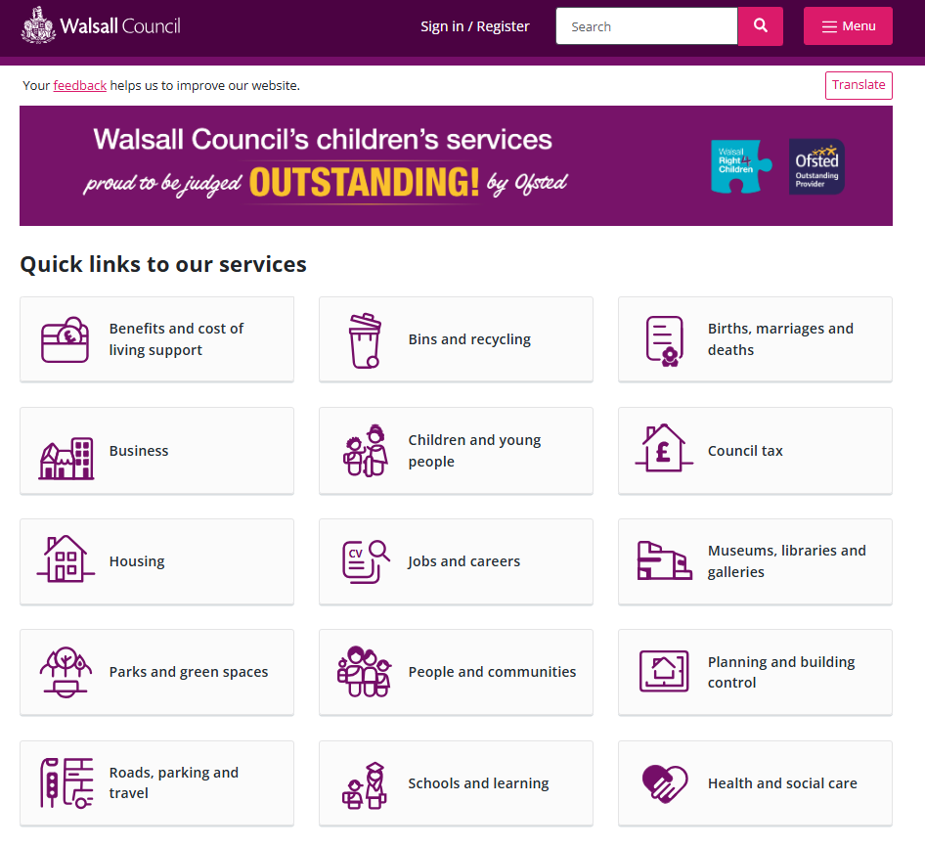
Applying online
All applications are made online
You will need to visit the Walsall council website

Slide 4

Applying online
Select “School Admissions”

Slide 5
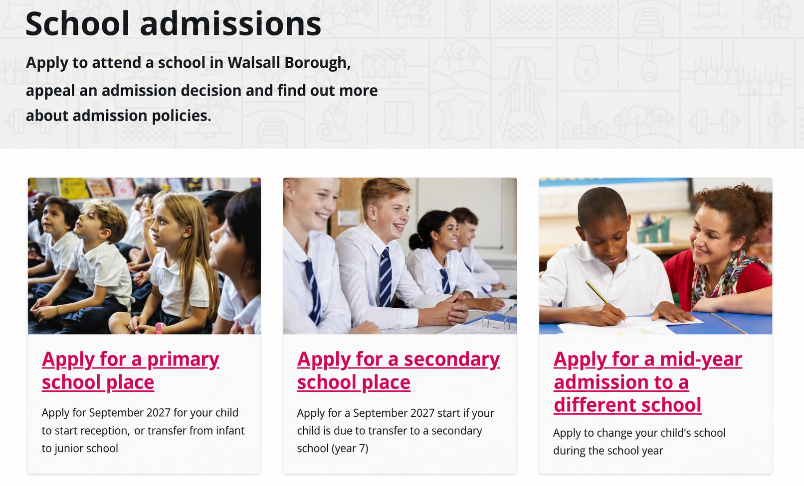

Applying online
Select “Apply for a secondary school place”

Slide 6
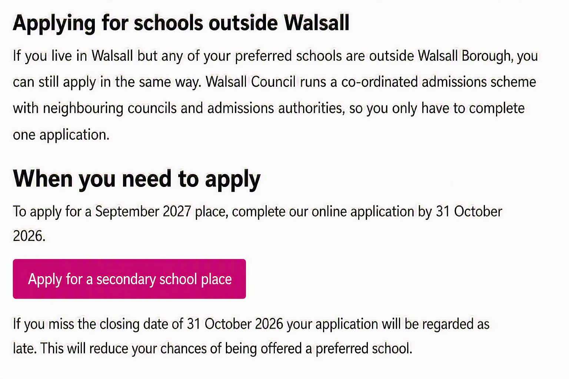
Applying online
Read through the information on the page and select
“Apply for a secondary school place”

Slide 7
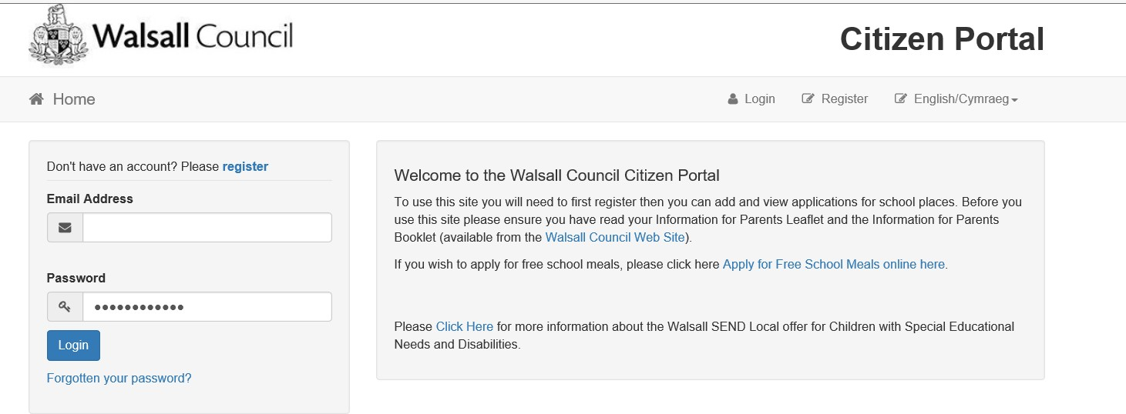

Applying online
Register and apply

Slide 8
Benefits of online applications
Anytime access available from Friday 11 September 2026 – Saturday 31 October 2026 for on-time applications
Paperless process
Secure and safe system.
You will receive email notification of your school place offer on 1 March 2027.
You can amend your application after it has been submitted up until the closing date of 31 October 2026. Please remember to re-submit your application after you make any changes

Slide 9
Useful Information
Ensure that you submit your application by 31 October 2026.
Do your research on prospective schools and attend open evenings.
Read the on-line information for parents' booklet on our website
You can list up to 5 school preferences; we strongly urge you to use all 5 preferences to maximise the opportunity to be offered a preferred school.
If your preferred schools are oversubscribed, your child will be placed on a waiting list, and the LA will allocate a place at the closest school to the child's home address with a vacancy.
Some schools require Supplementary Information Forms, please check the admission criteria for each school and submit on time directly to the schools.
We advise against listing 5 grammar schools – this will limit your chances of being offered a preferred school.
Include at least 1 local school that you feel your child would
have qualified for in previous years.

Slide 10
Result of a late application:
It is extremely important that you submit your application by 31 October 2026.
Late applications are processed after all those received on-time.
Your child might not be offered a place at any of your preferred schools, even though you may live very close to the school and have other children attending there.
Your child could be allocated a place at an alternative Walsall school
which may not be your most local, or one that you would have chosen.
It is unlikely that a place would become available at your preferred school from the waiting list.

Slide 11
Useful Information
Read the information for parents' booklet.
You MUST submit your application by 31 October 2026.
List 5 school preferences on your application.
Some schools require supplementary information forms – they MUST also be submitted on time, directly to the school.

Slide 12
Admissions and Education Sufficiency Team:
Use this website: School admissions | Walsall Council to view and download the Secondary Admissions Information for Parents Booklet.
Email: schooladmissionsadvice@walsall.gov.uk
The Admissions and Education Sufficiency Team aim to respond to all enquiries within 3 working days.

